Slide 1
Getting started with SharePoint Framework
Setup development environments

Slide 2
Agenda
Setting up your computer
Q&A

Slide 3
Setting up your computer

Slide 4
Setting Up Your Computer Steps
Install developer tools – Node.js & developer editor
Install Yeoman and gulp
Install Yeoman SharePoint generator
Install optional tools

Slide 5
Install developer tools – NodeJS and npm
Install NodeJS Long Term Support (LTS) version.
If you are using a Mac, it is recommended you use homebrew to install and manage NodeJS.
make sure you are running the latest npm
npm install -g npm
Linux
sudo npm install -g npm

Slide 6




Install developer tools – Code Editors
Visual Studio Code
Sublime
Atom
Webstorm
You can freely choose which JavaScript development IDE you want to use.

Slide 7
Using Visual Studio 2015 or 2017?
Visual Studio does not have as native development experience as JavaScript editors
Visual Studio does however integrate well to enterprise development tools
It’s recommended to use Visual Studio 2017, if you want use Visual Studio IDE
Notice that VS2017 community edition is free

Slide 8

Install Yeoman and gulp
Yeoman provides you project templates to start with your development
Gulp works as the task manager in your SharePoint Framework solution
SharePoint client-side development tools include a Yeoman generator for creating new SharePoint Framework solutions
npm install -g yo gulp
Notes:
Yeoman helps you kick-start new projects, and prescribes best practices and tools to help you stay productive. SharePoint client-side development tools include a Yeoman generator for creating new web parts. The generator provides common build tools, common boilerplate code, and a common playground web site to host web parts for testing.
Enter the following command to install Yeoman and gulp:
npm i -g yo gulp

Slide 9
Install Yeoman SharePoint generator
The Yeoman SharePoint Framework solution generator helps you quickly create a SharePoint client-side solution project with the right toolchain and project structure.
npm install -g @microsoft/generator-sharepoint
Notes:
The Yeoman SharePoint web part generator helps you quickly create a SharePoint client-side solution project with the right toolchain and project structure.
Enter the following command to install the Yeoman SharePoint generator:
npm i -g @microsoft/generator-sharepoint

Slide 10
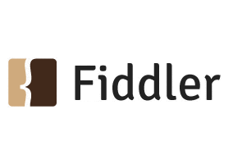


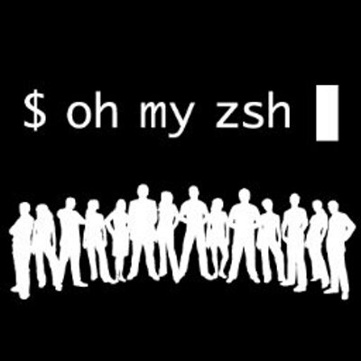

Other useful tools for development
Fiddler
Postman plugin for Chrome
Cmder for Windows
Oh My Zsh for Mac
Git source control tools
Notes:
Here are some tools that might come in handy as well:
Fiddler
Postman plugin for Chrome
Cmder for Windows
Oh My Zsh for Mac
Git source control tools

Slide 11
DEMO
Installing needed tools and libraries to your development environment
Notes:
Demo 3 – review dev env

Slide 12
Summary
Setting up your computer
Q&A

Slide 13
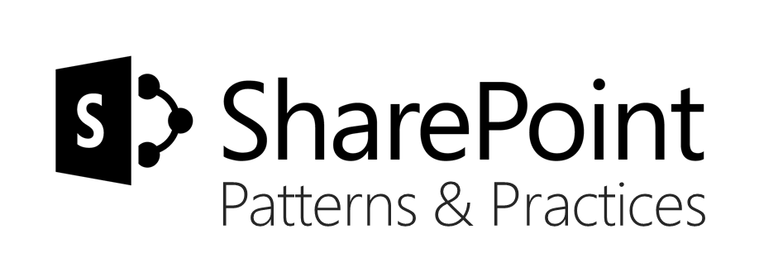
Sharing is caring…
Code samples and solutions
Reusable components
Guidance documentation
Monthly community calls
SharePoint Framework
SharePoint add-ins
Microsoft Graph
Office 365 APIs
http://aka.ms/SharePointPnP

Slide 14

Q&A

Slide 15


